Slide 1
A proposal to investigate three technical solutions to prevent dirty masjid toilet in Ankara Gençlik Parkı
Kutay Şenyiğit
21902377
ENG 401-12

Slide 2
Contents
Introduction
Problem Definition
Proposed Solutions
Criteria for Assessing Proposed Solutions
Proposed Research Methodology
References

Slide 3
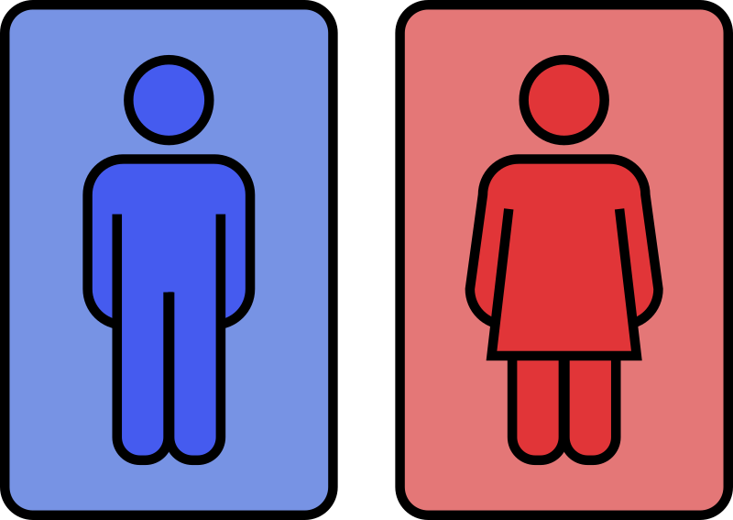
Introduction: Public Restrooms
The 2016 Healthy Hand Washing Survey, conducted by restroom fixture manufacturer Bradley Corporation
For the normal people, in average people urinate in every 4 hours [1].
People have an aversion to touching certain restroom surfaces operate the toilet flusher with their foot [2].
%70 say they have had an unpleasant experience due to the conditions in a public restroom [2].
London scientists say one out of six cell phones tests positive for fecal matter [2].
Fig. 1 [13]

Slide 4
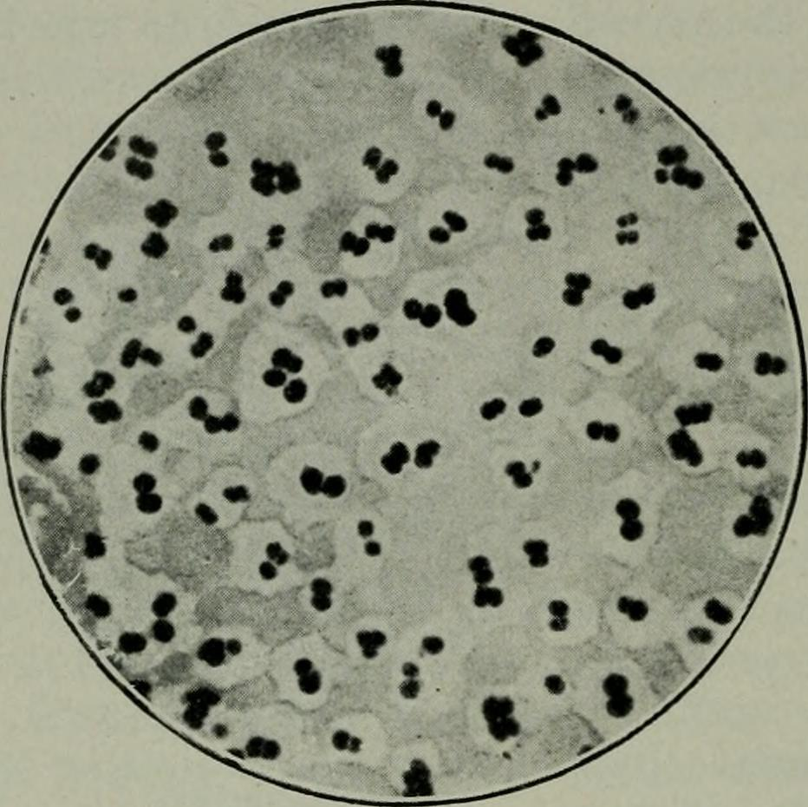
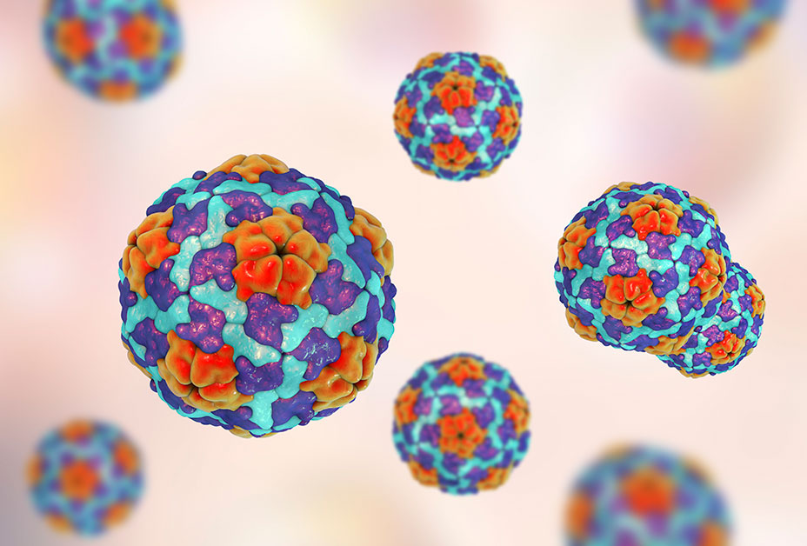

Introduction: Health Risks of Public Restrooms
Fig. 2: Pathogenic microbes [9]
Fig. 3: Hepatitis A [10]
Fig. 4: Salmonella [11]
Pathogenic microbes on toilets and other surfaces in public restrooms [3].
Hepatitis A in elementary school restrooms [3].
Salmonella in dorm toilets [3].

Slide 5

Introduction: Health Risks of Public Restrooms
Fig. 5: Norovirus [12]
Disease-causing viruses and bacteria, including norovirus in workspace, airplane and cruise ship bathrooms [3].

Slide 6
Introduction
ONE HUNDRED has initiated an online survey with 4546 participants in 8 countries in December 2020 [1].
%67
Agrees that the quality and hygiene of the toilets is a clear indicator for the general hygiene of a public space [1].
%32
A bad experience with quality and hygiene of toilet facilities in a public space is a reason to visit this place less often or to stay shorter [1].
Do not mind paying 1$, 1€ or 1£ for qualitative toilet facilities [1].
%44

Slide 7
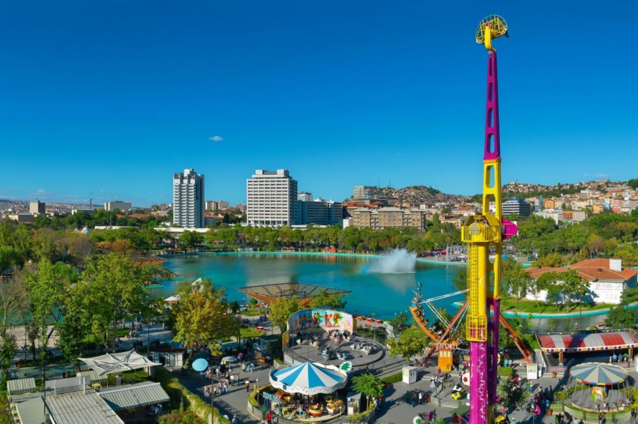
Introduction
Frequency of Visiting the Park
Frequency of visiting the park | Park visitors (n = 152) % | Local People (n= 150) (%)
Everyday | 9 | 1
At least 1 day in a week | 18 | 2
At least 1 day in two week | 6 | 3
At least 1 day in a month | 20 | 4
At least 1 day in a year | 45 | 33
Not visiting | – | 53
Never | – | 4
Sum | 100 | 100
Fig. 7: Gençlik Parkı Ankara [20]
Gençlik Parkı is located in the center of Ankara, Ulus [6].
It has a wedding hall, amusement park, opera house, places for drinking tea and restaurants [6].
%15.7 of visitors stay in Gençlik Parkı for more than 4 hours [5].
It has two public restrooms on the outside [7].
Fig. 6: Frequency table of visiting the park [5]

Slide 8
Introduction
Purpose
Impact
Significance
To make the restroom clean most of the time
To be able to call cleaning staff when needed
Prevent possible diseases

Slide 9
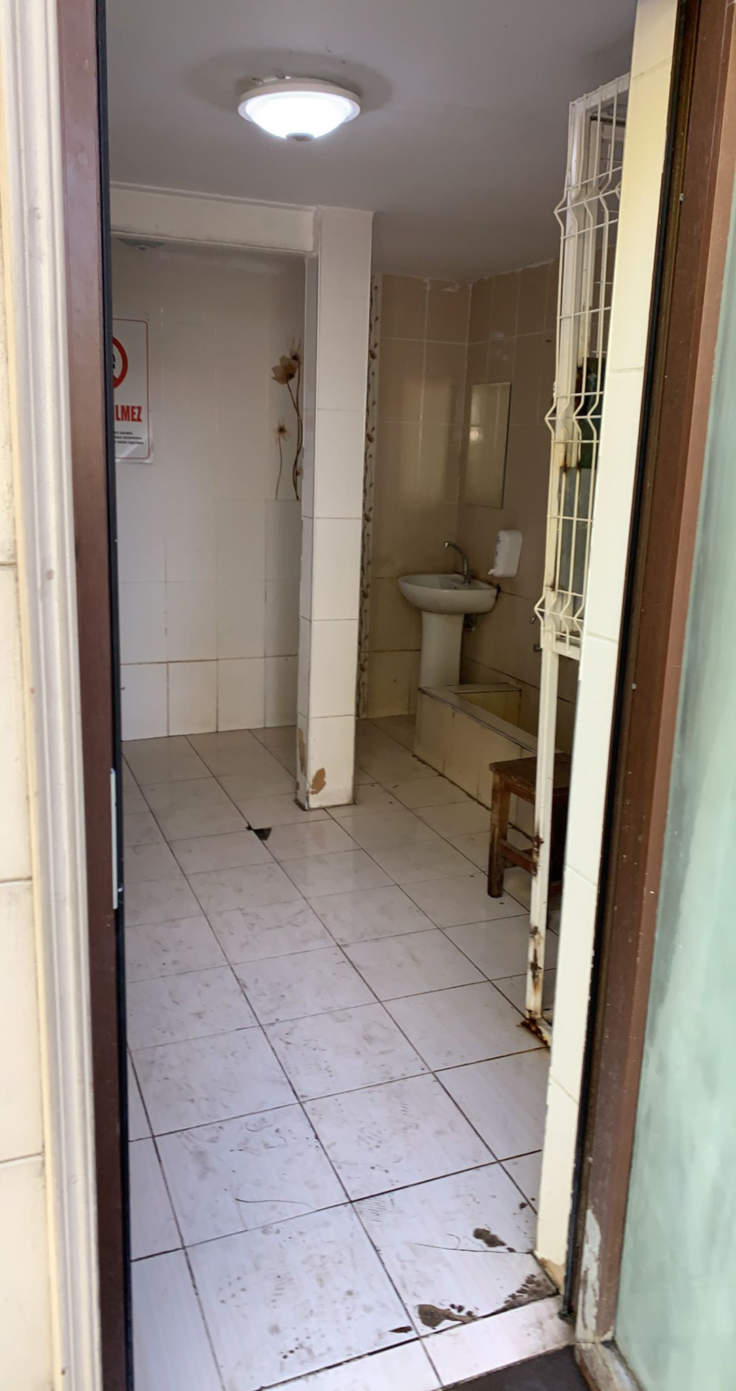
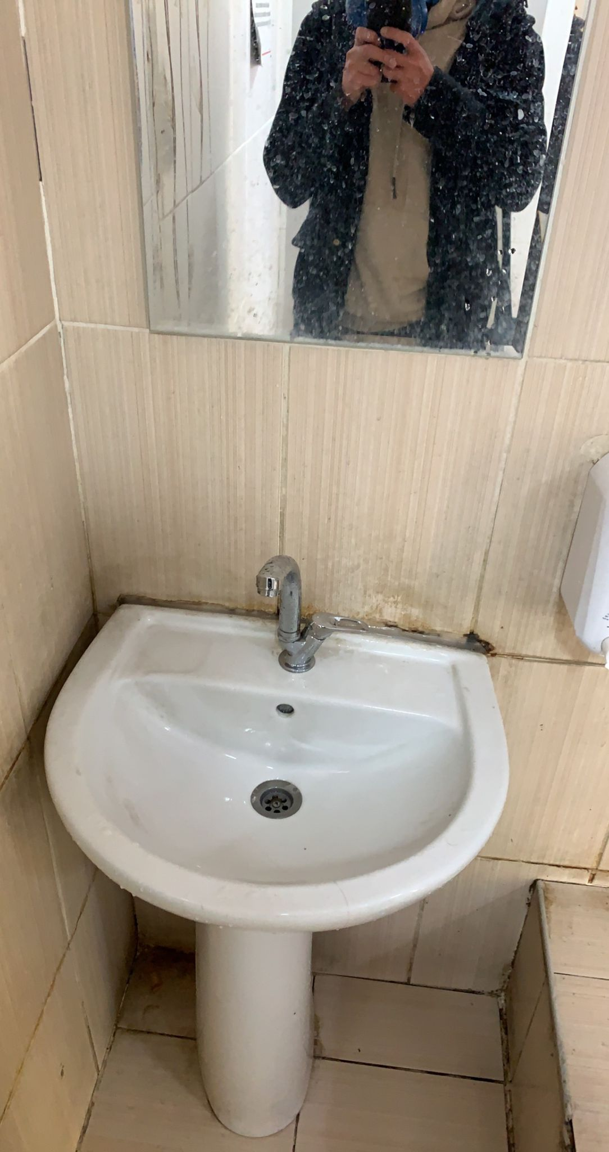
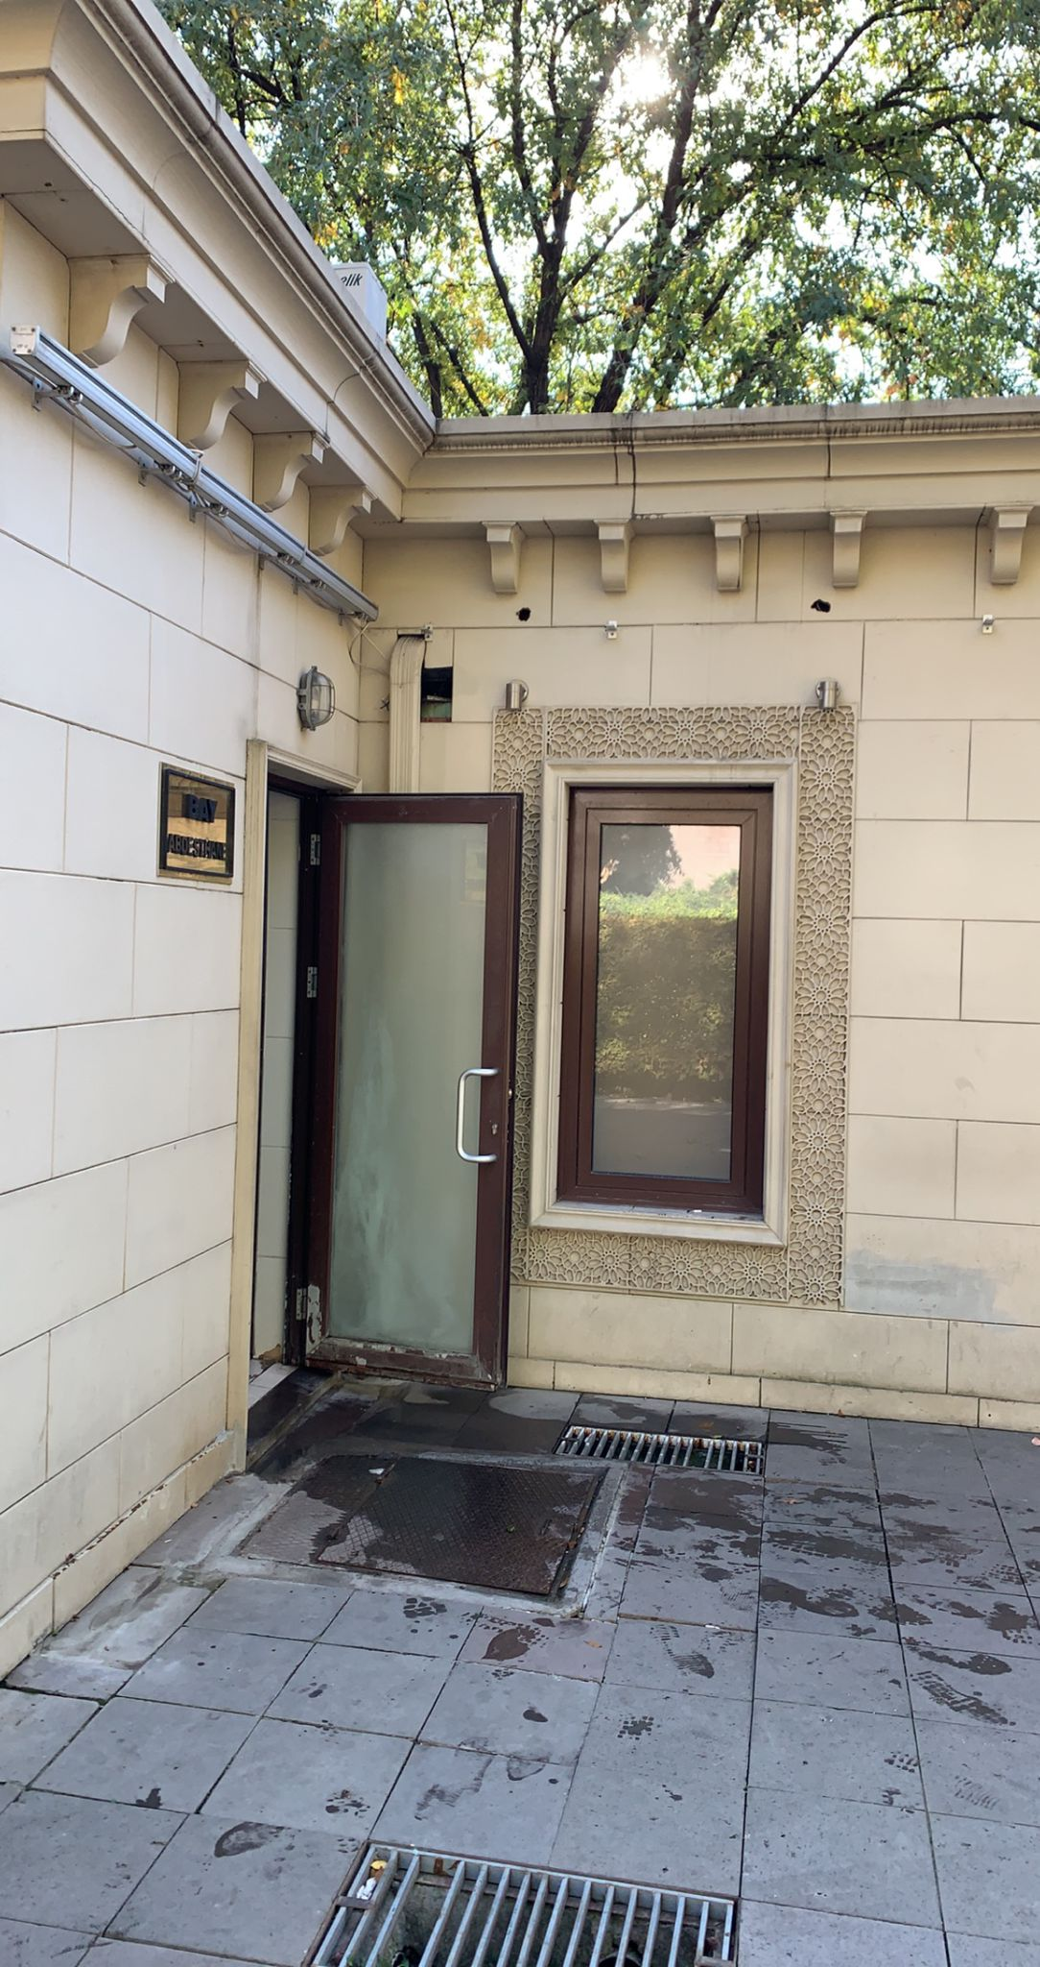
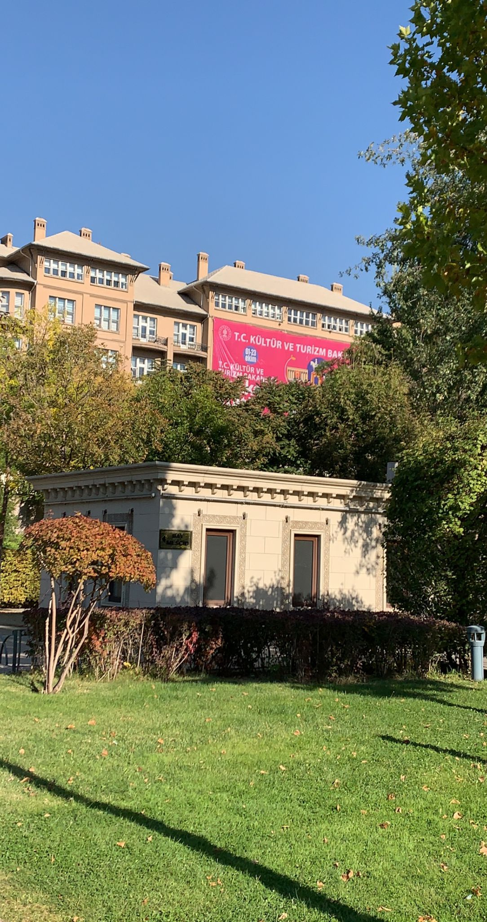
Problem Definition
Problem: Masjid toilet is not clean in Ankara Gençlik Parkı
Fig. 7: Entrance of the restroom [21]
Fig. 8: Sink of the restroom [21]
Fig. 9: Entrance [21]
Fig. 10: Masjid [21]

Slide 10
Problem Definition
Who: The people who visits Ankara Gençlik Parkı
What: Cleaning is done in a certain frequency not after a problem occurs
When: Always, but most at weekends and on special days like end of the school day [7]
Where: Ankara Gençlik Parkı
Why: Lack of ability to call staff when needed
How: This is an important problem because it increase risk of diseases

Slide 11
Problem Definition
Root Cause: Cleaning staff is not cleaning the restroom when it is needed.
Floors are wet and dirty
Sink is not clean
Two toilet cubicle are not clean
The restroom is cleaned everyday for only 5 times by municipality [7].

Slide 12
Proposed Solutions
1- A QR code for letting the staff know which part of the restroom has a problem
2- No Touch Button for calling the staff to indicate that there is a problem
3- An automated system for calling the staff that consists of a dirt detection system, water leak detector and waste bin fill-level sensors

Slide 13
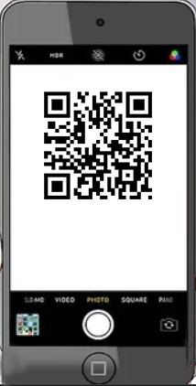
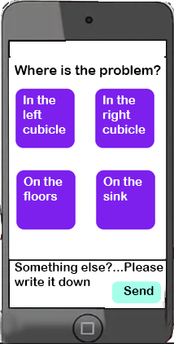

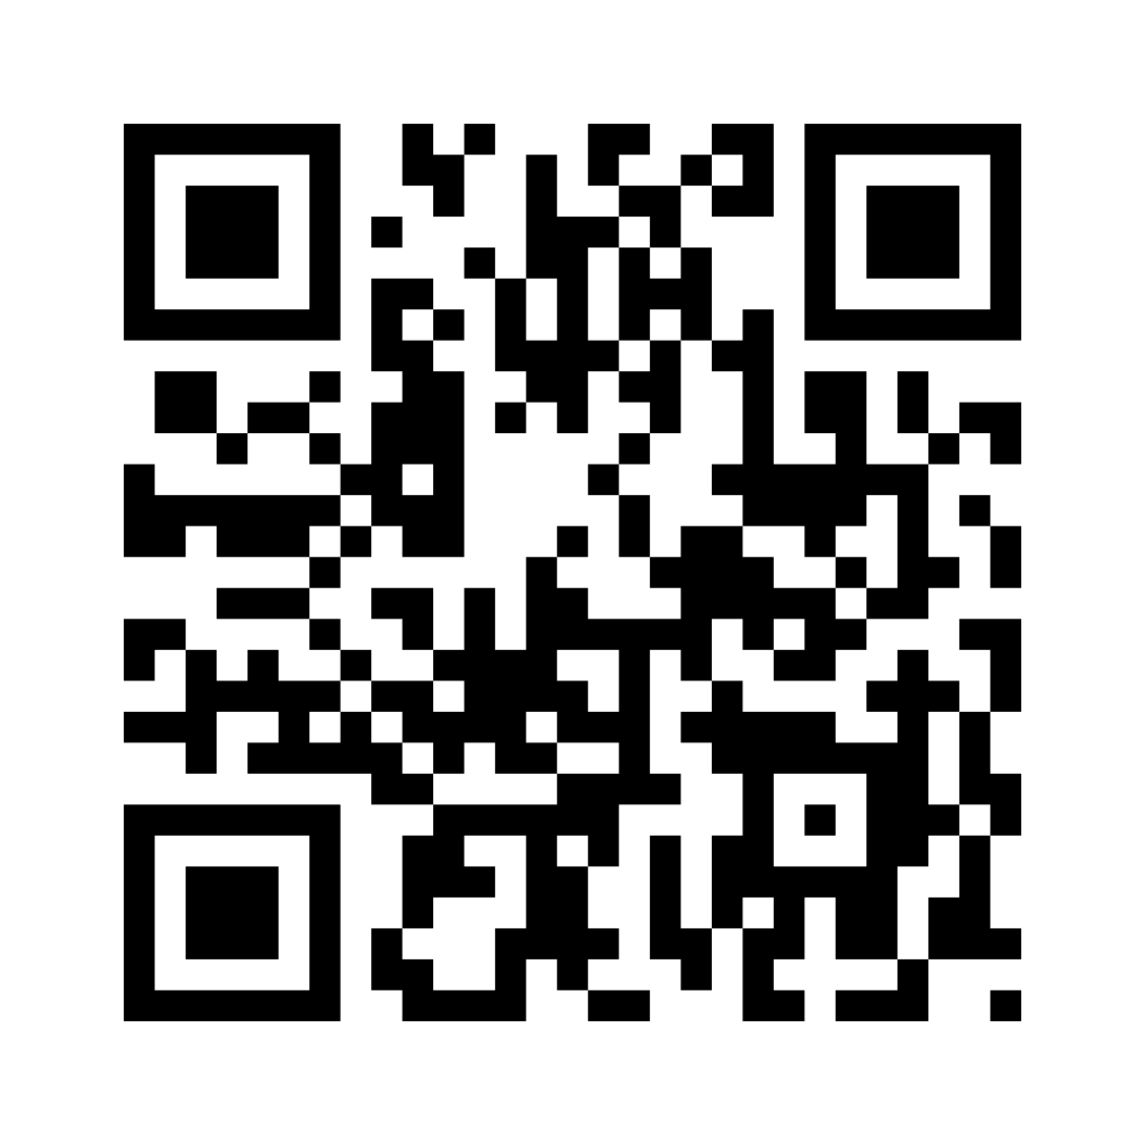
Solution 1: QR Code System
Fig. 11: QR Code System [8]

Slide 14
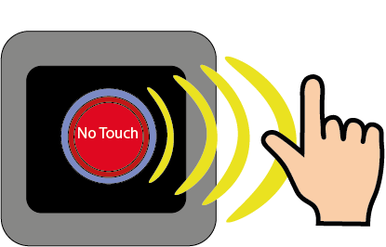
Solution 2: No Touch Button Notification System
Fig. 12: No Touch Button Notification System [9]

Slide 15
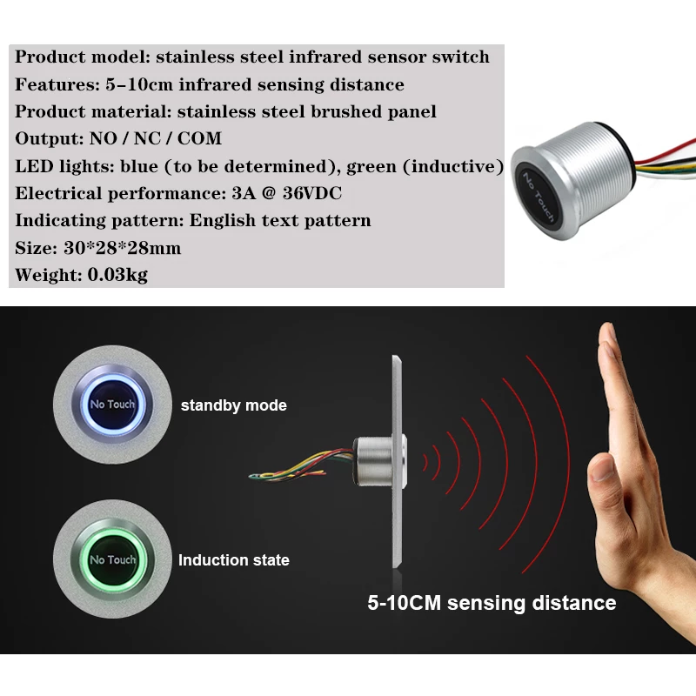
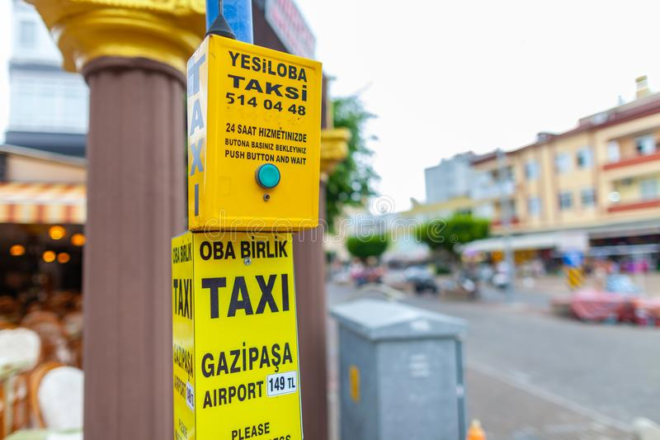
How it works?
Fig. 13: Taxi Buttons [19]
Fig. 14: No Touch Button [20]
1000 m - 3000 m distance range
Ability to send stop information

Slide 16
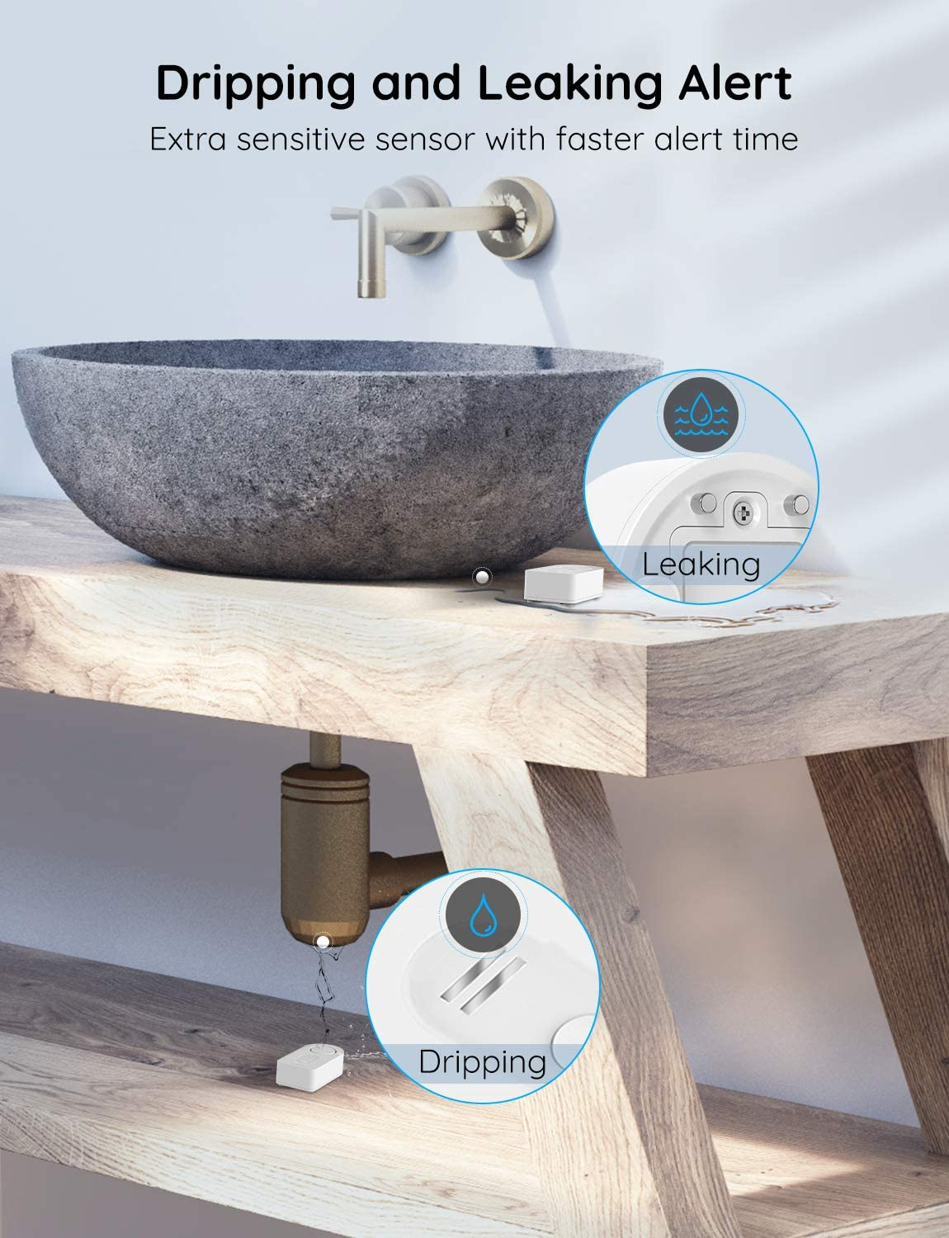
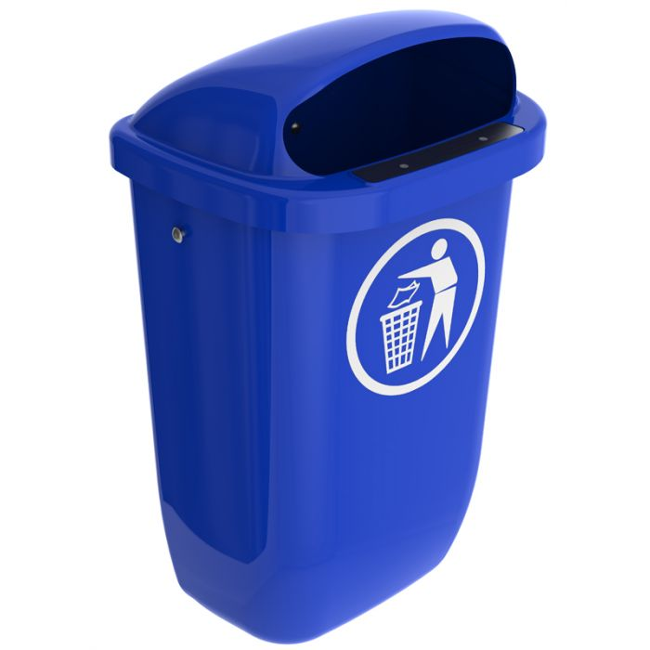
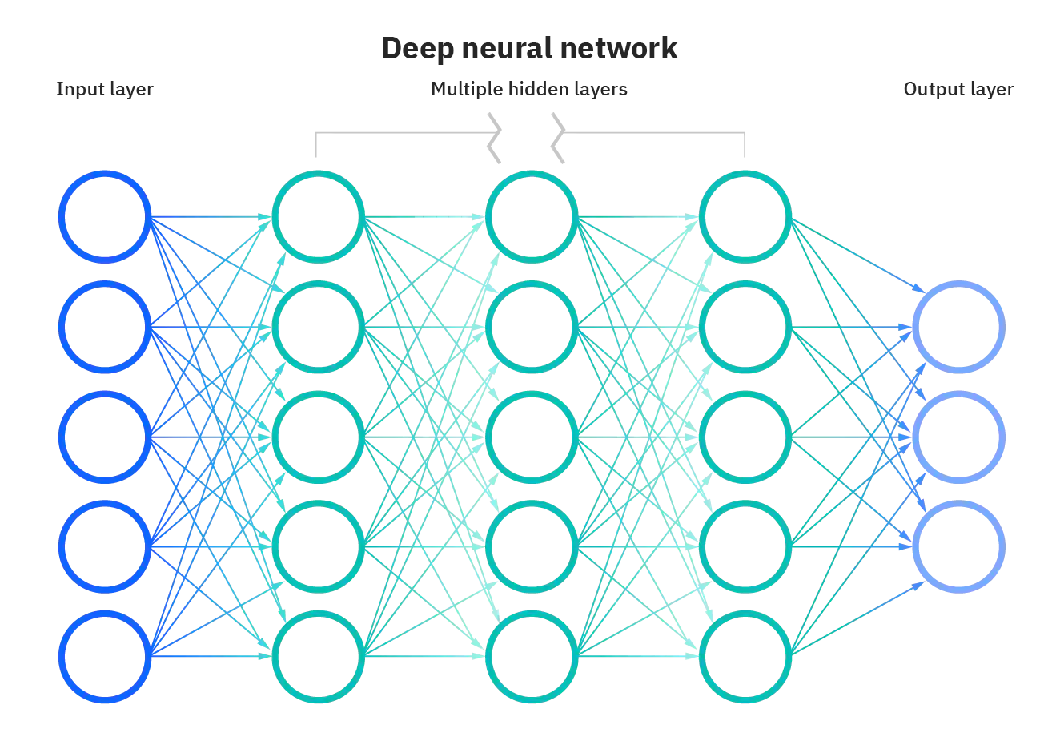
Solution 3: Automated System
Fig. 15 [15]
Fig. 16 [14]
Fig. 17 [16]
IoT enabled Bin [18].
Water Leak Detector [14].
Dirt detection algorithm [17].

Slide 17
Criteria for Assessing Proposed Solutions
1-COST
1.1 QR Code System
The cost of the design website
The cost of the domain and host of the website
The cost of the phones that will be given to the cleaning staff
1.2 No Touch Button System
The cost of the taxi button
The cost of the no touch button
1.3 Automated System
The cost of the IoT enabled bin
The cost of the water leak dedector
The cost of the systems that detecs dirt

Slide 18
Criteria for Assessing Proposed Solutions
2- Applicability
3- Efficiency

Slide 19
Proposed Research Methodology
Expert Opinion
Market Research
Literature Review
How the collected signals of the detectors will notify the staff will be consultant
How efficient the solutions are will be asked
Required hardwares, softwares or cloud services will be determined on internet
How efficient the solutions are will be researched

Slide 20
References
[1] “Urinary frequency,” Bladder & Bowel Community, 16-Aug-2021. [Online]. Available: https://www.bladderandbowel.org/bladder/bladder-conditions-and-symptoms/frequency/#:~:text=For%20most%20people%2C%20the%20normal,times%20they%20visit%20the%20toilet. [Accessed: 26-Oct-2022].
[2] “Survey reveals top ten restroom complaints/usage stats,” CleanLink. [Online]. Available: https://www.cleanlink.com/news/article/Survey-Reveals-Top-Ten-Restroom-ComplaintsUsage-Stats--19737. [Accessed: 26-Oct-2022].
[3]“Research,” ONE HUNDRED RESTROOMS, 13-Jan-2022. [Online]. Available: https://onehundredrestrooms.com/leading-in-public-restrooms/research/. [Accessed: 26-Oct-2022].
[4] A. Callahan, “How bad are the germs in public restrooms, really?,” The New York Times, 21-Jun-2022. [Online]. Available: https://www.nytimes.com/2022/06/21/well/live/public-bathrooms-health-safety.html. [Accessed: 26-Oct-2022].
[5] DEMİR E "Park Kullanım Kalıpları: Gençlik Parkı Ziyaretçileri Üzerine Bir Araştırma." Çağdaş Yerel Yönetimler, 14, ss.19 - 42, 2005.
[6] E. Özden, “Ankara Gençlik Parkı - Nerede - Nasıl Gidilir ?,” gezicenga.com, 22-Nov-2019. [Online]. Available: https://gezicenga.com/ankara-genclik-parki/. [Accessed: 26-Oct-2022].
[7] Anonymous, Staff. 2022.

Slide 21
References
[8] K. Şenyiğit, QR code system. 2022.
[9] K. Şenyiğit, No Touch Button Notification System. 2022.
[10] “Hepatitis A,” Centers for Disease Control and Prevention, 22-Jul-2022. [Online]. Available: https://www.cdc.gov/dotw/hepatitisa/index.html. [Accessed: 26-Oct-2022].
[11] P. D. İF. T. A. H. A. R. KÖKSAL, Salmonella Nedir, Belirtileri ve Tedavisi - Acıbadem Hayat, 23-Sep-2022. [Online]. Available: https://www.acibadem.com.tr/hayat/salmonella-nedir/. [Accessed: 26-Oct-2022].
[12] C. Arbanas, “How highly contagious norovirus infection gets its start,” Washington University School of Medicine in St. Louis, 19-Apr-2018. [Online]. Available: https://medicine.wustl.edu/news/how-fast-spreading-norovirus-infection-gets-its-start/. [Accessed: 26-Oct-2022].
[13] E. Akama, “Japanese toilet - toilet logo,” Japan Explorer, 18-Dec-2015. [Online]. Available: https://www.japanexplorer.com.au/japanese-toilet/toilet-logo/. [Accessed: 26-Oct-2022].
[14] “Amazon.” [Online]. Available: https://www.amazon.com/Detector-Wireless-Notification-Security-Basement/dp/B07J9HZ5VN. [Accessed: 25-Oct-2022].

Slide 22
References
[15] Axess Industries, “Poubelle d'extérieur en plastique: Corbeilles de propreté,” Axess Industries. [Online]. Available: https://www.axess-industries.com/mobilier-urbain/amenagement-urbain/corbeilles-de-proprete/poubelle-d-exterieur-en-plastique-p-182139. [Accessed: 26-Oct-2022].
[16] Filtreleme ölçütü: IBM Cloud Education, “Yapay Zeka (AI) nedir?,” IBM. [Online]. Available: https://www.ibm.com/tr-tr/cloud/learn/what-is-artificial-intelligence. [Accessed: 26-Oct-2022].
[17] B. Ramalingam, P. Veerajagadheswar, M. Ilyas, M. R. Elara, and A. Manimuthu, “Vision-based dirt detection and adaptive tiling scheme for selective area coverage,” Journal of Sensors, 30-Dec-2018. [Online]. Available: https://www.hindawi.com/journals/js/2018/3035128/. [Accessed: 26-Oct-2022].
[18] “Smart Bin Sensor: Iot bin sensor singapore,” Smart Bin Sensor | IoT Bin Sensor Singapore, 21-Mar-2022. [Online]. Available: https://v3smarttech.com/fill-level-sensors/. [Accessed: 26-Oct-2022].
[19] J. Hüttenhölscher, “Turkish taxi calling sign stands on a street editorial image - image of stands, motor: 128036625,” Dreamstime. [Online]. Available: https://www.dreamstime.com/antalya-turkey-september-turkish-taxi-calling-sign-stands-street-antalya-turkish-taxi-calling-sign-stands-street-image128036625. [Accessed: 26-Oct-2022].

Slide 23
References
[20] “Gençlik Parkı Gerçekte Kime devredildi? Taraflar Yanıt Verdi,” Independent Türkçe, 18-Jun-2019. [Online]. Available: https://www.indyturk.com/node/42931/ekonomi%CC%87/gen%C3%A7lik-park%C4%B1-ger%C3%A7ekte-kime-devredildi-taraflar-yan%C4%B1t-verdi. [Accessed: 26-Oct-2022].
[21] K. Şenyiğit, Gençlik Parkı Masjid Restroom. 2022.

